Slide 1
Introductory to Intermediate Machine Learning: From Theory to Practice with KNN, SVM, Decision Trees, Random Forests and Extreme Gradient Boosting
Prepared and Delivered:
Lumumba Wandera Victor

Slide 2
Introduction to Rstudio
What is R?
Although R is a programming language, it is unlike most others. It is designed to analyze data. It isn’t too difficult to learn, and is extremely popular. R has the advantage that it is free and open-source, and that thousands of users have contributed “add-on” packages that are readily downloadable by anyone.
R is found in all areas of academia that encounter data, and in many private and public organizations. R is great for any job or task that uses data.

Slide 3
Where to get R and Rstudio
Both are free and open-source. Download and install R first: https://cran.r-project.org/bin/windows/base/ (for Windows) or https://cran.r-project.org/bin/macosx/ (for Mac).
Then, download and install RStudio from https://www.rstudio.com/products/rstudio/download/.

Slide 4
Open RStudio
Search your computer for RStudio.exe and open the application. It should look something like the image in the next slide

Slide 5
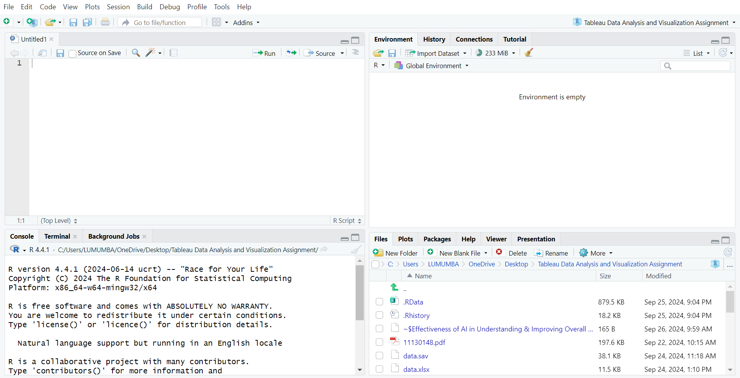
Rstudio Environment

Slide 6
R Pane Layout

Slide 7
CHARGES PER MODULE
NUMBER OF PEOPLE | 1-5 PEOPLE | 6-10 PEOPLE | 11> PEOPLE
CHARGES | KSHS 5000 PER PERSON | KSHS 4000 PER PERSON | KSHS 3000 PER PERSON

Slide 8
Module 1:
Introduction to Machine Learning
What is Machine Learning
Machine Learning (ML) refers to the ability of machines to learn from data and make decisions or predictions based on that data without human intervention.
Instead of being explicitly programmed to perform specific tasks, machine learning models improve their performance by identifying patterns in large datasets and adapting their behavior accordingly.
These models can be used for tasks like classification, regression, clustering, and more.

Slide 9
Differences Between AI, ML, and Deep Learning:
1. Artificial Intelligence (AI):
Definition: AI is the broadest concept and refers to the simulation of human intelligence by machines. It involves the creation of systems capable of performing tasks that typically require human intelligence, such as visual perception, speech recognition, decision-making, and language translation.
Scope: AI includes both rule-based systems (e.g., if-then logic) and learning systems (like machine learning and deep learning).
Techniques Used: AI uses various techniques, including search algorithms, expert systems, and learning-based approaches like ML and DL.
Example: A chatbot that can hold a conversation or an autonomous car that can drive itself.

Slide 10
Machine Learning (ML):
Definition: ML is a subset of AI that focuses specifically on systems that can learn from data. In ML, algorithms are trained on datasets to recognize patterns, make predictions, or improve their accuracy over time without being explicitly programmed for specific tasks.
Scope: ML is narrower than AI, as it deals solely with learning from data. It covers a range of techniques such as supervised learning, unsupervised learning, and reinforcement learning.
Techniques Used: Popular algorithms include decision trees, support vector machines (SVM), k-nearest neighbors (k-NN), and neural networks.
Example: A spam filter that learns to classify emails as spam or not spam based on previous examples.

Slide 11
Deep Learning (DL):
Definition: DL is a specialized subfield of ML, focusing on neural networks with many layers (hence "deep"). These networks are capable of learning complex representations from massive amounts of data and are particularly effective in tasks involving images, audio, and natural language.
Scope: Deep learning is more specific than ML, as it deals with neural networks that have multiple hidden layers (hence the term "deep"). It is often applied in scenarios where large amounts of data and high computational power are available.
Techniques Used: Deep learning uses architectures like Convolutional Neural Networks (CNNs) for image recognition, Recurrent Neural Networks (RNNs) for time-series data or language processing, and transformers for advanced NLP tasks.
Example: A self-driving car’s vision system that processes camera inputs and recognizes objects, or an image recognition system classifying images of cats and dogs.

Slide 12
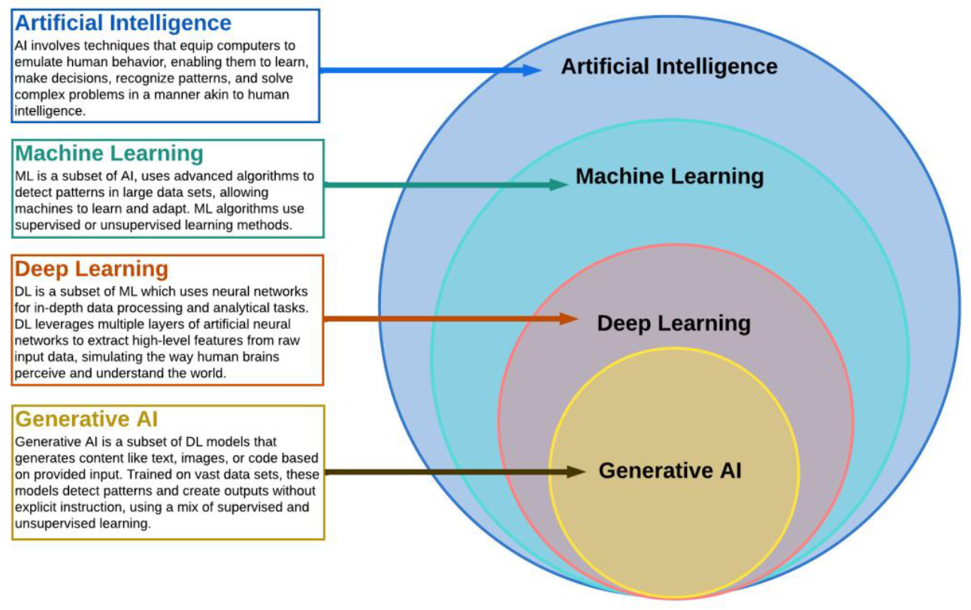
Diagrammatic Representation of AI, ML, and Deep Learning

Slide 13
Difference Between AI, ML and Deep Learning
Aspect | Artificial Intelligence (AI) | Machine Learning (ML) | Deep Learning (DL)
Scope | Broad: Encompasses any intelligent behavior | Narrower: Focuses on data-driven learning systems | Narrowest: Specializes in multi-layered neural networks
Techniques | Rule-based, symbolic reasoning, ML included | Supervised, unsupervised, and reinforcement learning | Neural networks with many layers (e.g., CNNs, RNNs)
Complexity | Handles simple and complex tasks | Solves data-driven problems with structured data | Handles very complex tasks like image and language understanding
Data Requirement | Varies, may not need large datasets | Requires structured data for training | Requires massive amounts of data for training
Examples | Chatbots, robotic process automation | Email spam detection, recommendation engines | Autonomous vehicles, speech recognition systems

Slide 14
Types of Machine Learning
Supervised Learning:
Supervised learning involves training a model using labeled data, where both the input data and the corresponding output labels are provided.
The model learns to map inputs to outputs based on these examples, allowing it to make predictions or classifications for new, unseen data. It can be applied to two main types of problems:

Slide 15
Classification
Goal: To predict a categorical output (label) from input data. The output can belong to one of several predefined classes.
How it Works: The algorithm learns from a labeled dataset where the categories are known. Once trained, the model can classify new data points into one of the classes.
Examples:
  Email Spam Detection: Classifying emails as "spam" or "not spam."
  Image Classification: Identifying whether an image contains a dog, cat, or bird.
Common Algorithms:
  Logistic Regression
  Support Vector Machines (SVM)
  k-Nearest Neighbors (k-NN)
  Decision Trees, Random Forests

Slide 16
Regression
Goal: To predict a continuous numerical output based on input data.
How it Works: The model is trained on a dataset where the output is a real number (continuous variable). It learns to predict the value based on the input features.
Examples:
  House Price Prediction: Predicting the price of a house based on factors like size, location, and age.
  Stock Price Forecasting: Predicting future stock prices based on historical data.
Common Algorithms:
  Linear Regression
  Polynomial Regression
  Decision Trees, Random Forests (for regression tasks)
  Support Vector Regression (SVR)

Slide 17
Unsupervised Learning
Unsupervised learning is used when the data does not have labeled outputs. The algorithm tries to discover hidden patterns, structures, or relationships in the data without being explicitly guided.
It is mainly used for the following tasks:

Slide 18
Clustering
Goal: To group similar data points into clusters based on their features, with the aim of finding inherent patterns or structures.
How it Works: The algorithm attempts to find groups in the data based on feature similarity. The data points within a cluster are more similar to each other than to those in other clusters.
Examples:
  Customer Segmentation: Grouping customers based on purchasing behavior to identify distinct market segments.
  Image Segmentation: Clustering pixels in an image to distinguish between different regions or objects.
Common Algorithms:
  k-Means Clustering
  Hierarchical Clustering
  DBSCAN (Density-Based Spatial Clustering of Applications with Noise)

Slide 19
Dimensionality Reduction
Goal: To reduce the number of features (dimensions) in a dataset while preserving as much relevant information as possible.
How it Works: The algorithm transforms high-dimensional data into a lower-dimensional space, often for visualization or to improve the efficiency of other algorithms (like clustering or classification).
Examples:
  Principal Component Analysis (PCA): Used to reduce the number of variables while retaining most of the variance in the data.
  t-Distributed Stochastic Neighbor Embedding (t-SNE): Often used for visualizing high-dimensional data in 2D or 3D.
Common Algorithms:
  Principal Component Analysis (PCA)
  t-SNE
  Autoencoders (in deep learning)

Slide 20
REINFORCEMENT LEARNING
Goal: To train an agent to make a sequence of decisions by interacting with an environment to maximize cumulative rewards.
How it Works: The agent learns by trial and error, receiving feedback from its actions in the form of rewards or penalties. The goal is to maximize the total reward over time by learning an optimal policy for decision-making.
Examples:
  Game Playing: Reinforcement learning is used to train agents to play games like chess or Go (e.g., AlphaGo).
  Robotics: Training robots to perform tasks by interacting with their environment and learning the best actions to take.

Slide 21
Key Concepts
  Agent: The learner or decision-maker.
  Environment: The world with which the agent interacts.
  Action: A move the agent makes within the environment.
  Reward: The feedback the agent receives after performing an action, which could be positive or negative.
  Policy: The strategy the agent uses to decide its next action based on the current state.
Common Algorithms:
  Q-Learning
  Deep Q-Networks (DQN)
  Proximal Policy Optimization (PPO)

Slide 22
Tabular Differences
Learning Type | Goal | Common Tasks | Key Algorithms | Example Applications
Supervised Learning | Learn from labeled data to make predictions or classifications | - Classification (spam detection) | - Logistic Regression | - Fraud detection
 |  | - Regression (price prediction) | - Random Forest | - House price prediction
 |  |  | - SVM
Unsupervised Learning | Discover hidden patterns in unlabeled data | - Clustering (customer segmentation) | - k-Means | - Market segmentation
 |  | - Dimensionality reduction (PCA) | - Hierarchical Clustering | - Data visualization
 |  |  | - PCA
Reinforcement Learning | Learn optimal actions through trial and error to maximize reward | - Decision-making (games, robotics) | - Q-Learning | - Autonomous driving
 |  |  | - Deep Q-Networks (DQN) | - Game AI
 |  |  | - Proximal Policy Optimization (PPO)

Slide 23
Supervised Learning Workflow
Problem Formulation
Data collection and preparation.
Train-Test split.
Model training and evaluation.
Model tuning and deployment.

Slide 24
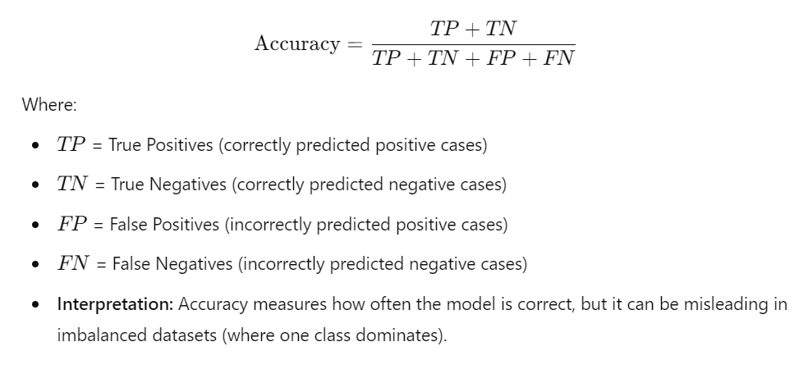
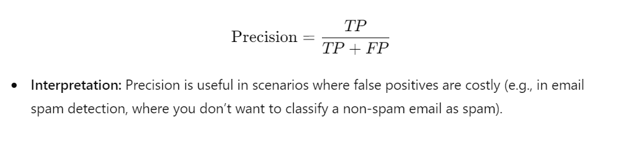
Evaluation Metrics for Classification
Precision (Positive Predictive Value)
Definition: Precision is the proportion of true positive predictions out of all positive predictions made by the model. It answers the question: "Of all the instances predicted as positive, how many are actually positive?"
Accuracy
Definition: Accuracy is the proportion of correctly classified instances (both true positives and true negatives) out of all instances.

Slide 25
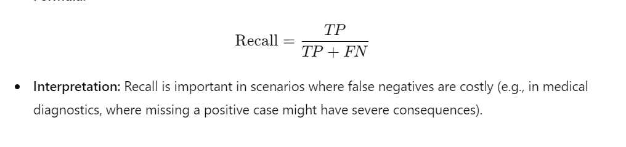
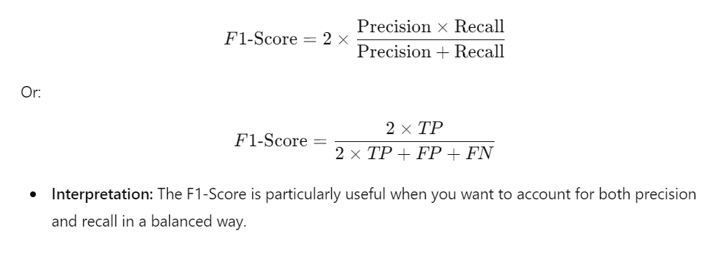
Evaluation Metrics for Classification
Recall (Sensitivity, True Positive Rate)
Definition: Recall is the proportion of actual positive cases that were correctly predicted by the model. It answers the question: "Of all the actual positive instances, how many were correctly predicted?"
F1-Score
Definition: The F1-Score is the harmonic mean of Precision and Recall. It provides a single metric that balances both precision and recall, especially useful when the class distribution is imbalanced.

Slide 26
Confusion Matrix
Definition: The confusion matrix is a table that summarizes the performance of a classification algorithm by comparing the predicted labels with the actual labels.
It shows the number of true positives (TP), true negatives (TN), false positives (FP), and false negatives (FN).
A typical confusion matrix looks like this for binary classification:

Slide 27
Confusion Matrix
 | Predicted Positive | Predicted Negative
Actual Positive | True Positive (TP) | False Negative (FN)
Actual Negative | False Positive (FP) | True Negative (TN)

Slide 28
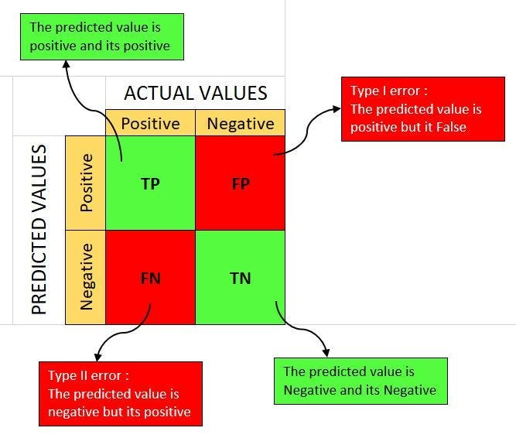
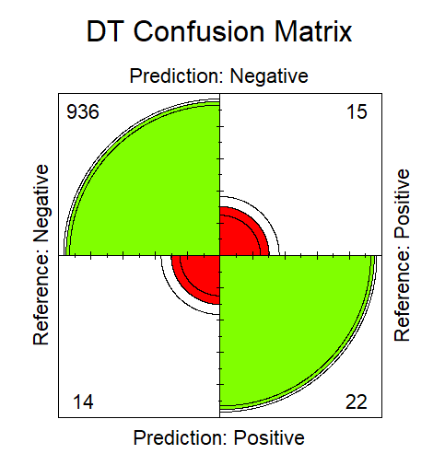
Alternative Graphical for Confusion Matrix

Slide 29
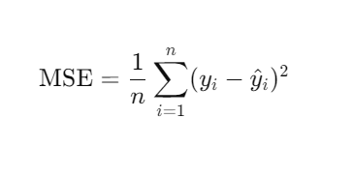
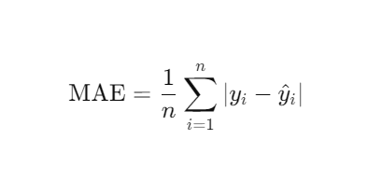
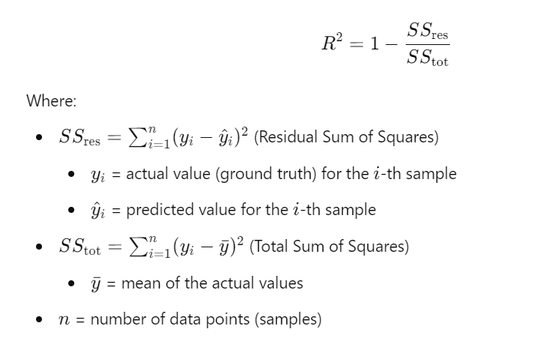
Evaluation Metrics for Regression
Mean Absolute Error (MAE)
Mean Squared Error (MSE)
R-Squared.

Slide 30
Train-Test Split and Cross-Validation
Why Split the Data?
Splitting the data into training and testing (and sometimes validation) sets is essential for several reasons:
Model Evaluation:
  Training vs. Testing: By training a model on one subset of data (training set) and evaluating it on another (testing set), we can assess how well the model generalizes to unseen data. This helps avoid overfitting, where a model performs well on training data but poorly on new data.
Performance Metrics:
  Evaluating the model on a separate test set allows for unbiased performance metrics. It gives a realistic estimate of how the model will perform in a real-world scenario.
Hyperparameter Tuning:
  A validation set can be used for tuning hyperparameters without using the test data. This further prevents data leakage and ensures that the evaluation remains valid.
Model Comparison:
  Splitting the data allows for fair comparisons between different models or algorithms. All models are evaluated on the same test set, ensuring that the performance metrics are consistent.

Slide 31
Cross-Validation Techniques
Cross-validation is a statistical method used to estimate the skill of machine learning models.
It is particularly useful when the dataset is small, as it helps ensure that the model is trained and tested multiple times on different subsets of the data.

Slide 32
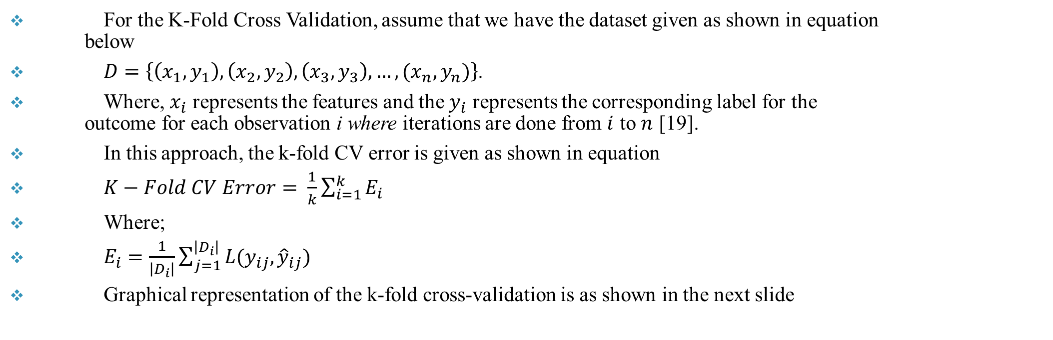
K-Folds Cross Validation
For the K-Fold Cross Validation, assume that we have the dataset given as shown in equation below
$D=\left\{\left(x_{1},y_{1}\right), \left(x_{2},y_{2}\right),\left(x_{3},y_{3}\right),…,(x_{n},y_{n})\right\}$.
Where, $x_{i}$ represents the features and the $y_{i}$ represents the corresponding label for the outcome for each observation i where iterations are done from $i$ to $n$ [19].
In this approach, the k-fold CV error is given as shown in equation
$K−Fold CV Error= \frac{1}{k}\sum_{i=1}^{k}{E_{i}}$
Where;
$E_{i}=\frac{1}{\left|D_{i}\right|}\sum_{j=1}^{\left|D_{i}\right|}{L(y_{ij},{\hat{y}}_{ij})}$
Graphical representation of the k-fold cross-validation is as shown in the next slide

Slide 33
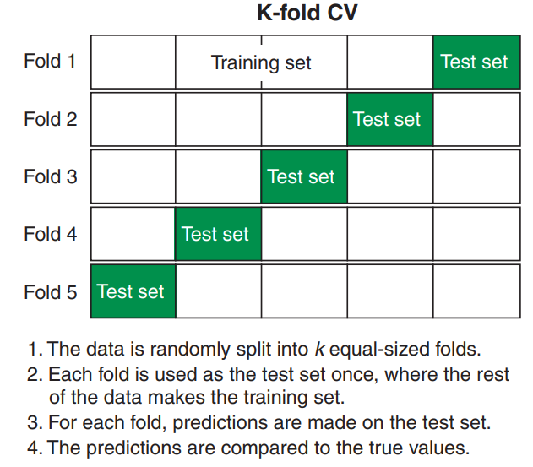
Graphical Representation of K-Folds CV

Slide 34
Repeated K-Folds Cross Validation
The repeated k-fold cross-validation is an extension of k-fold cross-validation.
Repeated k-fold cross-validation provides a way to improve the estimated performance of a machine-learning model.
The technique involves simply repeating the cross-validation procedure multiple times and reporting the mean result across all folds from all runs .

Slide 35
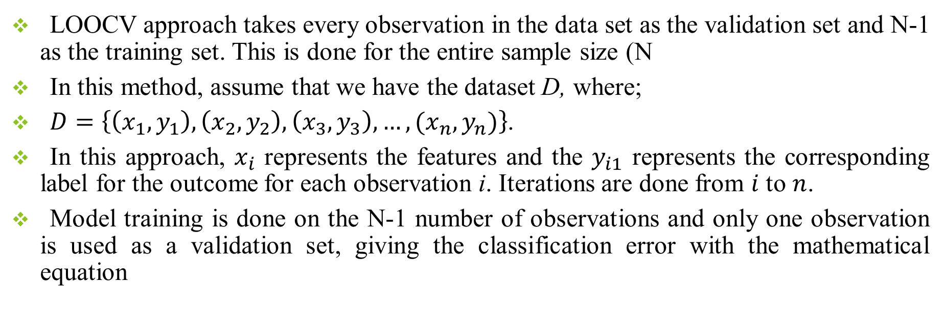
Leave One Out Cross Validation (LOOCV)
LOOCV approach takes every observation in the data set as the validation set and N-1 as the training set. This is done for the entire sample size (N
In this method, assume that we have the dataset D, where;
$D=\left\{\left(x_{1},y_{1}\right), \left(x_{2},y_{2}\right),\left(x_{3},y_{3}\right),…,(x_{n},y_{n})\right\}$.
In this approach, $x_{i}$ represents the features and the $y_{i1}$ represents the corresponding label for the outcome for each observation i. Iterations are done from $i$ to $n$.
Model training is done on the N-1 number of observations and only one observation is used as a validation set, giving the classification error with the mathematical equation

Slide 36
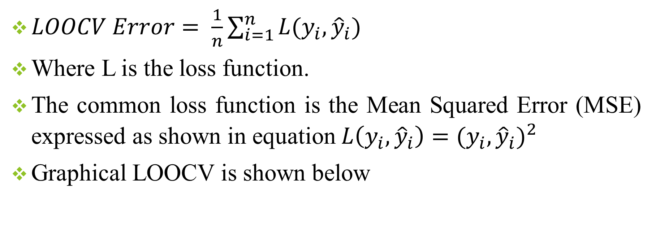
LOOCV cont’
$LOOCV Error= \frac{1}{n}\sum_{i=1}^{n}{L(y_{i},{\hat{y}}_{i})}$
Where L is the loss function.
The common loss function is the Mean Squared Error (MSE) expressed as shown in equation $L\left(y_{i},{\hat{y}}_{i}\right)={(y_{i},{\hat{y}}_{i})}^{2}$
Graphical LOOCV is shown below

Slide 37
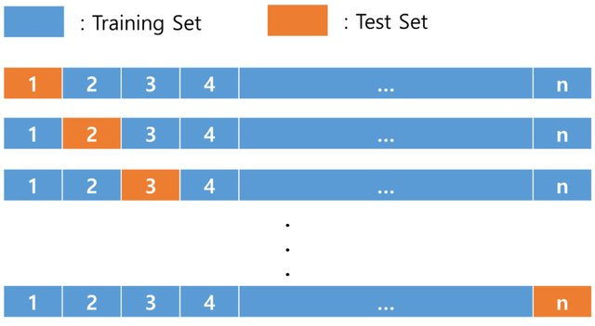
Graphical Representation of LOOCV

Slide 38
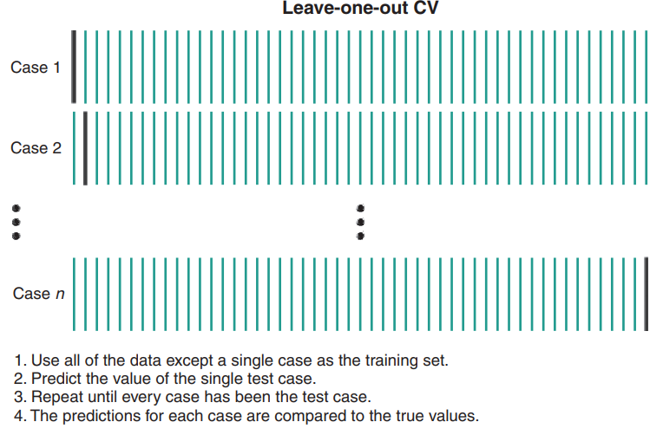
Alternative LOOCV Visual

Slide 39
Module 2: Machine Learning Algorithms

Slide 40
Key Algorithms for Classification, Regression and Clustering
Supervised Learning
1. Classification Algorithms:
K-NN
SVM
Decision Tree
Random Forest etc.
2. Regression Algorithms
K-NN
SVM
Random Forest
Extreme Gradient Boosting (XGBoost) etc.
Unsupervised Learning
1. Clustering
K-Means Clustering
Hierarchical Clustering
2. Principle Component Analysis
Reinforcement Learning

Slide 41
Classification Algorithms
Logistic Regression:
Used for binary and multi-class classification tasks.
Based on the logistic function, it estimates the probability that a given instance belongs to a specific class.
Suitable for problems like spam detection or determining whether a customer will churn.
K-Nearest Neighbors (K-NN):
A simple, instance-based learning algorithm.
Classifies new data points based on the majority class among the K-nearest points in the feature space.
Effective for tasks like image classification and recommendation systems.
Support Vector Machines (SVM):
Works by finding a hyperplane that best separates data points from different classes.
Particularly useful for high-dimensional spaces and complex decision boundaries.
Commonly applied to text classification and image recognition tasks.

Slide 42
Cont.’
Decision Trees:
A tree-like model where data is split based on feature values.
Each internal node represents a feature, and each leaf node represents a class label.
Easy to interpret and can handle both categorical and numerical data.
Random Forest:
An ensemble learning method that builds multiple decision trees and combines their outputs.
Provides better accuracy than individual decision trees by reducing overfitting.
Widely used in applications such as fraud detection and medical diagnosis.
Naive Bayes:
Based on Bayes’ Theorem and assumes that features are independent given the class label.
A fast and efficient classifier, often used for text classification and spam filtering.
XGBoost (Extreme Gradient Boosting):
An advanced version of gradient boosting that is highly efficient and scalable.
Often achieves state-of-the-art results in classification tasks like customer churn prediction and financial risk modeling.

Slide 43
Regression Algorithms
Linear Regression:
  One of the simplest algorithms, where the relationship between input features and output is modeled as a linear function.
  Used in tasks like predicting house prices or sales forecasting.
Ridge Regression:
  A regularized form of linear regression that adds a penalty to the size of the coefficients to prevent overfitting.
  Effective when dealing with multicollinearity in datasets.
Lasso Regression:
  Similar to Ridge Regression but uses L1 regularization, which can shrink some coefficients to zero, making it useful for feature selection.
  Often used in scenarios with many features, such as gene selection in bioinformatics.
Support Vector Regression (SVR):
  A regression version of the SVM algorithm.
  SVR tries to fit the best line within a margin, minimizing the error while also reducing overfitting.
  Suitable for predicting continuous values like stock prices or temperature.

Slide 44
Continuation
Decision Trees for Regression:
  Like decision trees for classification, but the outputs are continuous values.
  Splits data based on feature values and predicts the mean value of the target variable for each leaf node.
  Used for regression tasks like predicting energy consumption or income levels.
Random Forest for Regression:
  Similar to Random Forest for classification but applied to regression problems.
  Combines the predictions of multiple decision trees to improve accuracy and reduce overfitting.
  Used in applications like predicting car prices or credit risk.
XGBoost for Regression:
  An optimized version of gradient boosting that works well for large-scale regression tasks.
  It iteratively improves predictions by combining weak learners.
  Commonly used in competitive data science challenges and for time series forecasting.

Slide 45
Machine Learning Flow Chart

Slide 46
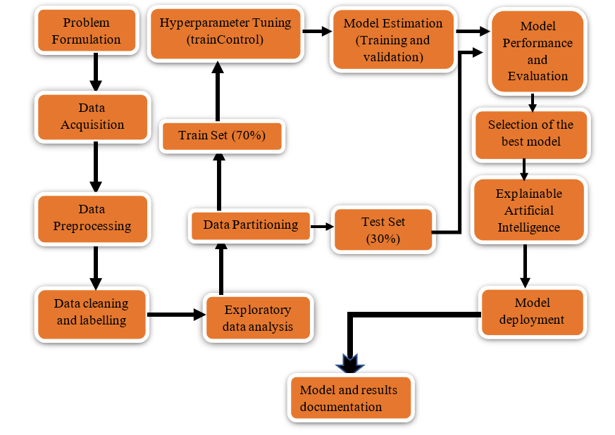
Steps in Machine Learning

Slide 47
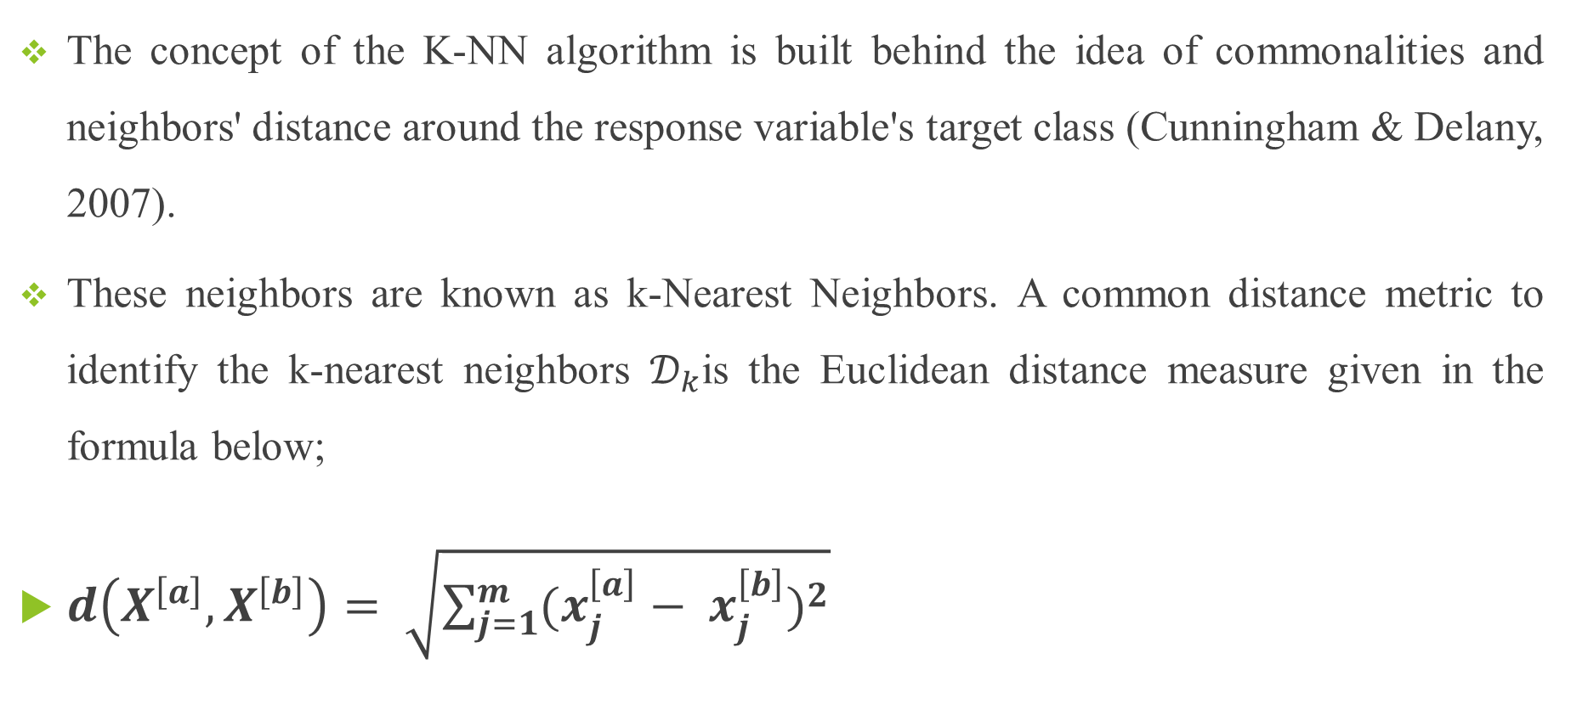
K-Nearest Neighbors (KNN)
The concept of the K-NN algorithm is built behind the idea of commonalities and neighbors' distance around the response variable's target class (Cunningham & Delany, 2007).
These neighbors are known as k-Nearest Neighbors. A common distance metric to identify the k-nearest neighbors $𝒟_{k}$is the Euclidean distance measure given in the formula below;
$d\left(X^{\left[a\right]}, X^{\left[b\right]}\right)= \sqrt{\sum_{j=1}^{m}{{(x_{j}^{\left[a\right]}− x_{j}^{\left[b\right]})}^{2}}}$

Slide 48
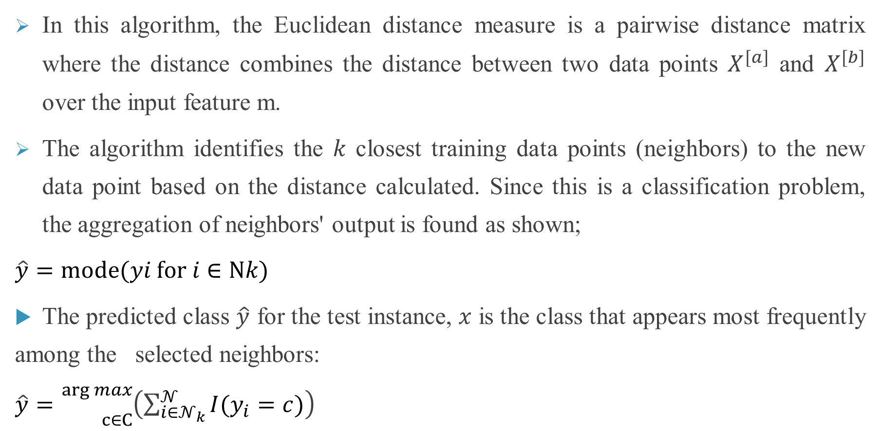
K-NN Continuation
In this algorithm, the Euclidean distance measure is a pairwise distance matrix where the distance combines the distance between two data points $X^{[a]}$ and $X^{[b]}$ over the input feature m.
The algorithm identifies the 𝑘 closest training data points (neighbors) to the new data point based on the distance calculated. Since this is a classification problem, the aggregation of neighbors' output is found as shown;
$\hat{y}​=mode(yi​ for i∈Nk​)$
The predicted class $\hat{y}$ for the test instance, 𝑥 is the class that appears most frequently among the selected neighbors:
$\hat{y}​={}_{c∈C}^{\arg{max}}{\left(\sum_{i∈𝒩_{k}}^{𝒩}{I(y_{i}=c)}\right)}$

Slide 49
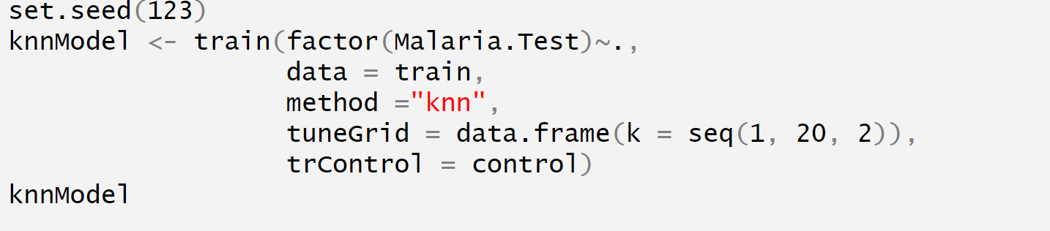
Practical Example: KNN Implementation in R

Slide 50
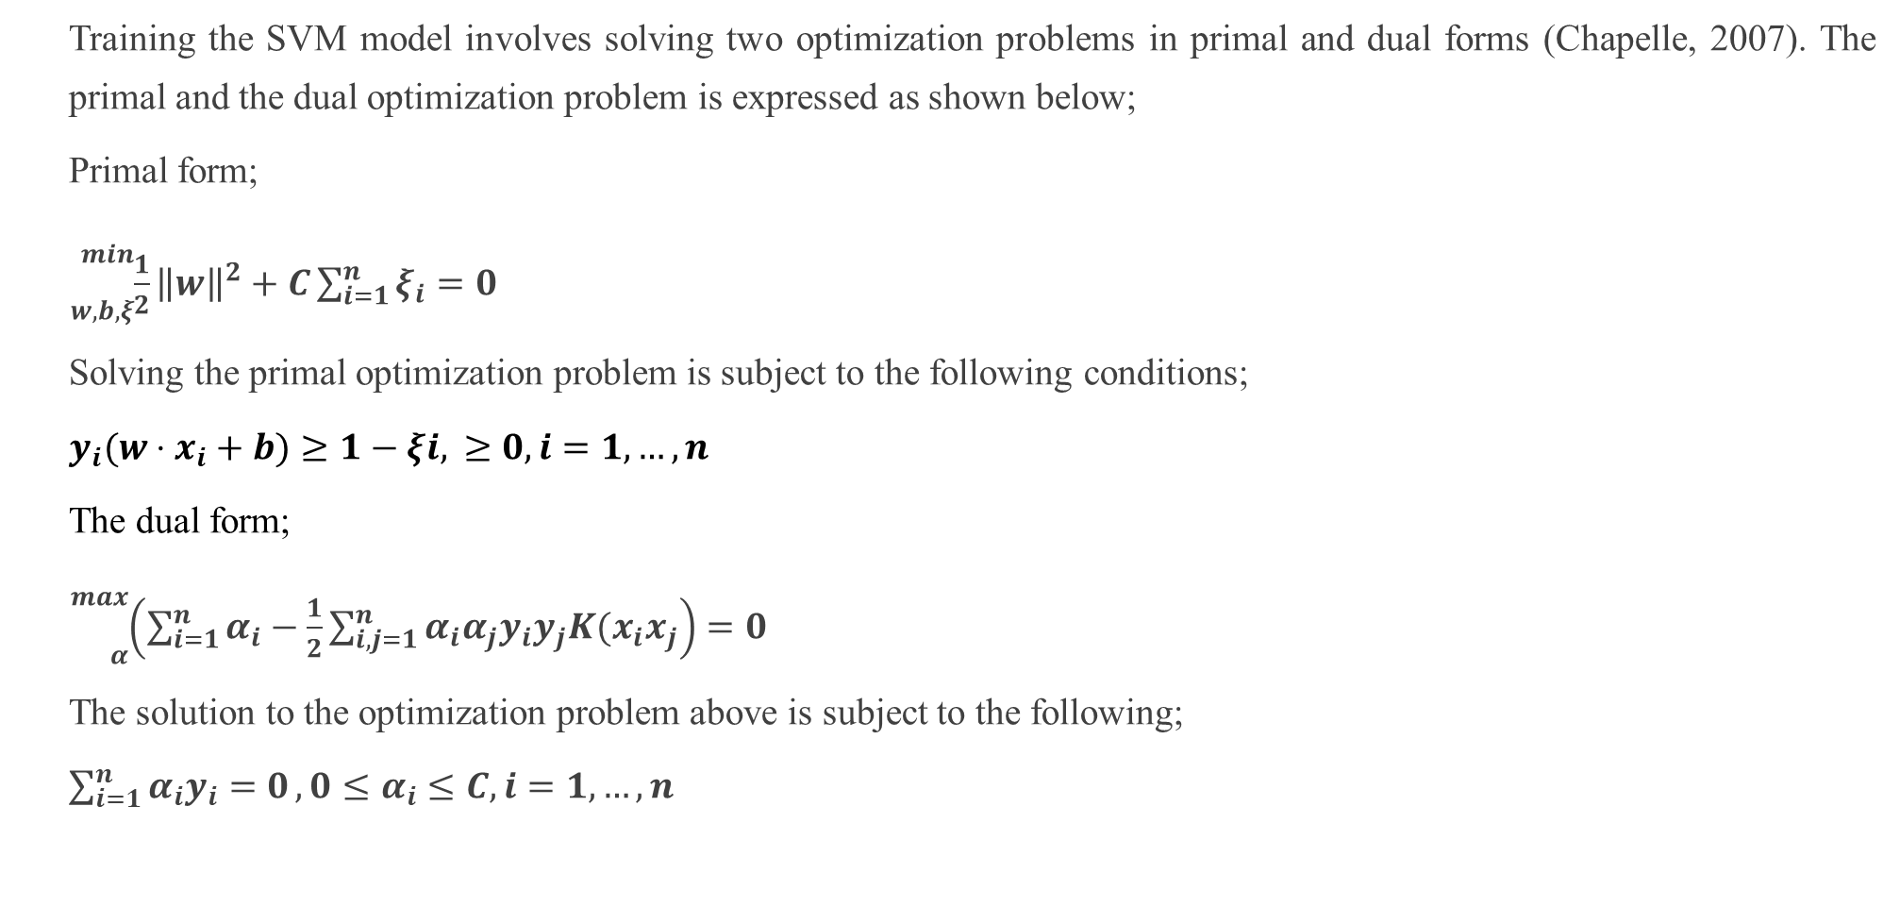
Support Vector Machine (SVM)
Training the SVM model involves solving two optimization problems in primal and dual forms (Chapelle, 2007). The primal and the dual optimization problem is expressed as shown below;
Primal form;
${}_{w,b,ξ}^{min}{\frac{1}{2}{\left\|w\right\|}^{2}+C\sum_{i=1}^{n}{ξ_{i}}}=0$
Solving the primal optimization problem is subject to the following conditions;
$y_{i}​(w⋅x_{i}+b)≥1−ξi​,​≥0,i=1,…,n$
The dual form;
${}_{α}^{max}{\left(\sum_{i=1}^{n}{α_{i}}−\frac{1}{2}\sum_{i,j=1}^{n}{α_{i}α_{j}y_{i}y_{j}K(x_{i}x_{j}}\right)}=0$
The solution to the optimization problem above is subject to the following;
$\sum_{i=1}^{n}{α_{i}y_{i}=0}, 0≤α_{i}≤C, i=1,…,n$

Slide 51
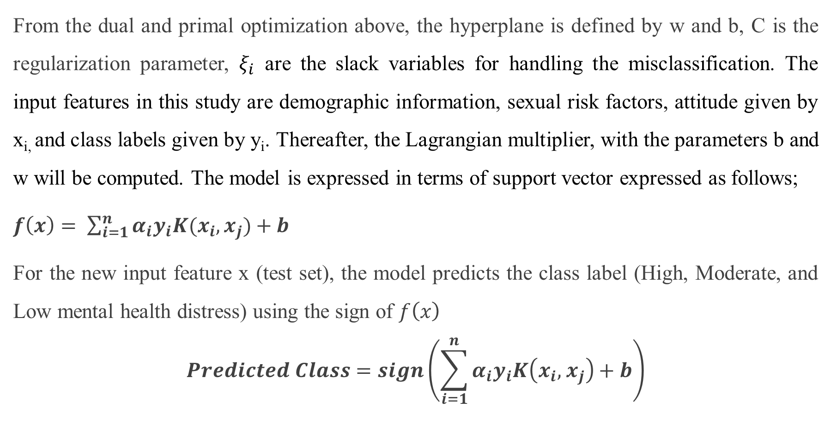
Continuation of SVM
From the dual and primal optimization above, the hyperplane is defined by w and b, C is the regularization parameter, $ξ_{i}$ are the slack variables for handling the misclassification. The input features in this study are demographic information, sexual risk factors, attitude given by x_{i,} and class labels given by y_{i}. Thereafter, the Lagrangian multiplier, with the parameters b and w will be computed. The model is expressed in terms of support vector expressed as follows;
$f\left(x\right)= \sum_{i=1}^{n}{α_{i}y_{i}K(x_{i}, x_{j}})+b$
For the new input feature x (test set), the model predicts the class label (High, Moderate, and Low mental health distress) using the sign of $f\left(x\right)$
$$Predicted Class=sign\left(\sum_{i=1}^{n}{α_{i}y_{i}K\left(x_{i},{ x}_{j}\right)+b}\right)$$

Slide 52
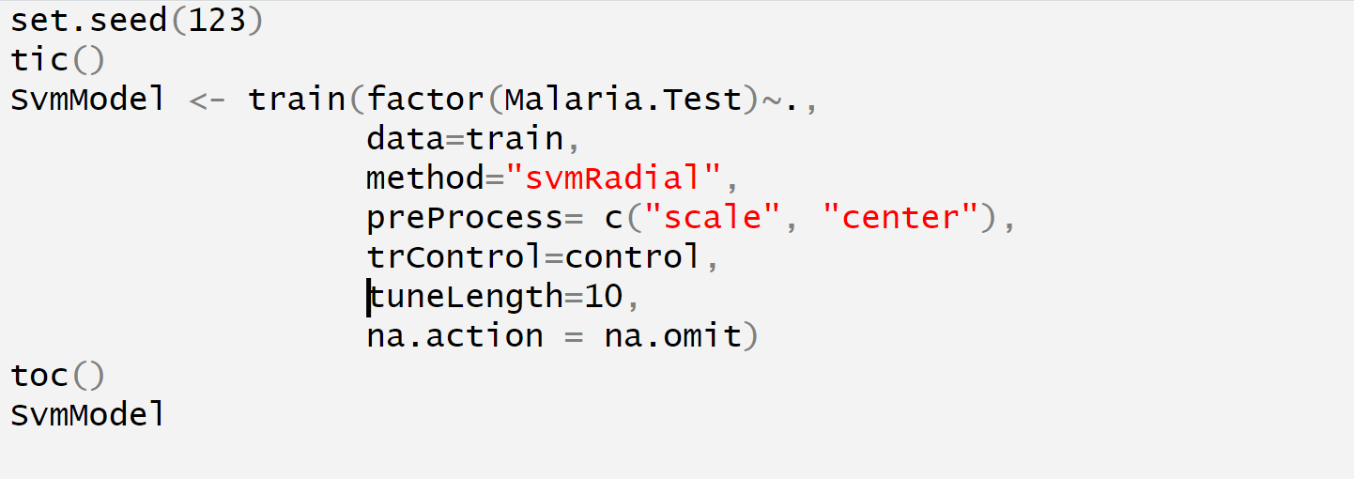
Practical Example: SVM Implementation in R

Slide 53
Decision Trees
A Decision tree is a supervised learning algorithm used for both classification and regression tasks. It is a tree-like structure where:
Internal nodes represent a decision based on the value of a feature.
Branches represent the outcome of the decision, splitting the data based on a feature's value.
Leaf nodes represent the final decision or output (class label or continuous value).
How it Works:
The dataset is split into subsets based on the most significant feature.
At each step, the algorithm chooses the feature that best separates the data, using criteria like Gini Impurity or Information Gain.
The tree grows until it reaches a stopping condition, such as a maximum depth or a minimum number of samples per leaf.

Slide 54
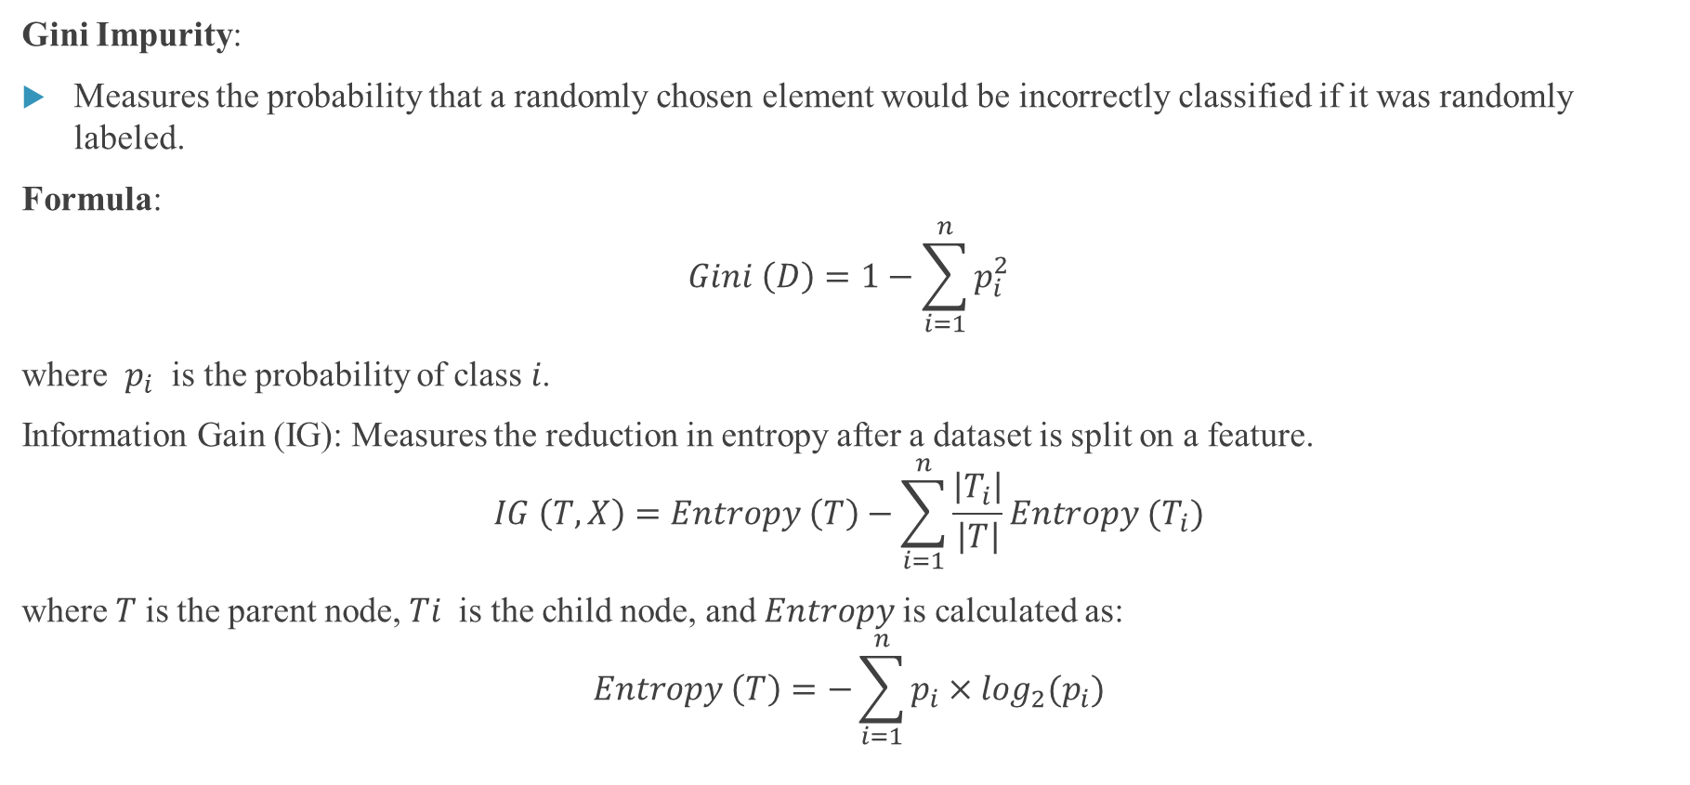
Continuation of the Decision Tree
Gini Impurity:
Measures the probability that a randomly chosen element would be incorrectly classified if it was randomly labeled.
Formula:
$$Gini \left(D\right)=1−\sum_{i=1}^{n}{p_{i}^{2}}$$
where $p_{i}$​ is the probability of class 𝑖.
Information Gain (IG): Measures the reduction in entropy after a dataset is split on a feature.
$$IG \left(T, X\right)=Entropy \left(T\right)−\sum_{i=1}^{n}{\frac{\left|T_{i}\right|}{\left|T\right|}}Entropy (T_{i})$$
where 𝑇 is the parent node, 𝑇𝑖​ is the child node, and 𝐸𝑛𝑡𝑟𝑜𝑝𝑦 is calculated as:
$$Entropy \left(T\right)=−\sum_{i=1}^{n}{p_{i}×\log_{2}(p_{i})}$$

Slide 55
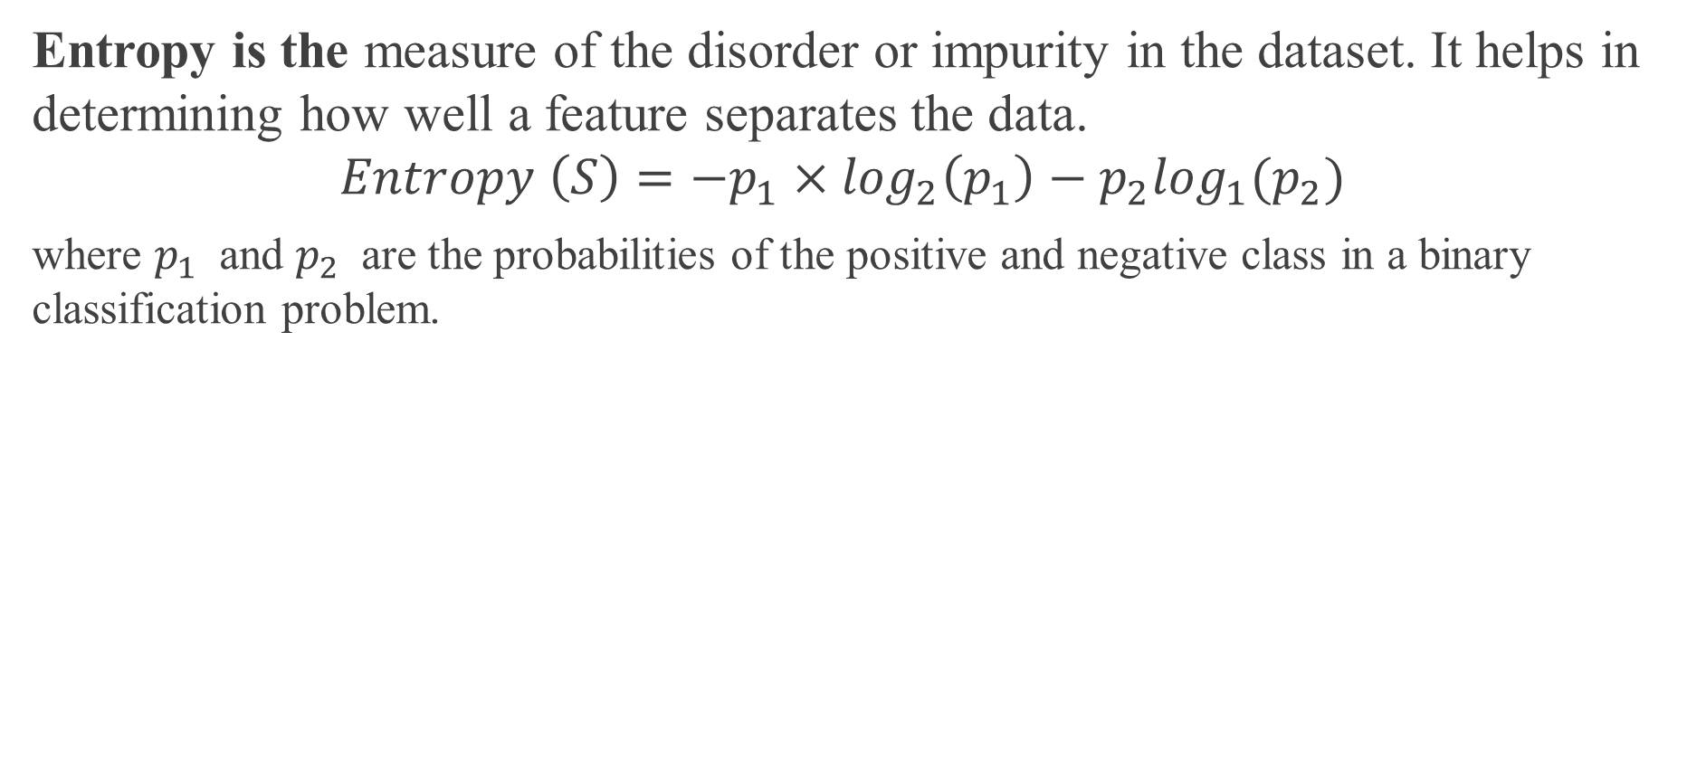
What is an Entropy
Entropy is the measure of the disorder or impurity in the dataset. It helps in determining how well a feature separates the data.
$$Entropy \left(S\right)=−p_{1}×\log_{2}\left(p_{1}\right)−p_{2}\log_{1}(p_{2})$$
where $p_{1}$​ and $p_{2}$​ are the probabilities of the positive and negative class in a binary classification problem.

Slide 56
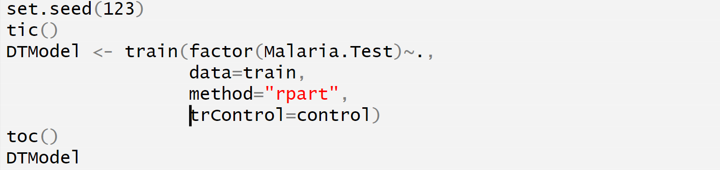
Practical Example: Decision Tree Implementation in R

Slide 57
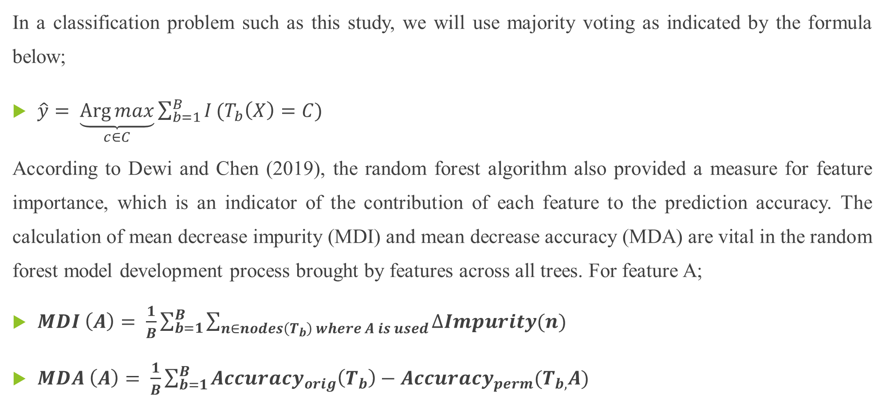
Random Forest
In a classification problem such as this study, we will use majority voting as indicated by the formula below;
$\hat{y}= \underset{c∈C}{\underbrace{\operatorname{Arg}{max}}}\sum_{b=1}^{B}{I}(T_{b}\left(X\right)=C)$
According to Dewi and Chen (2019), the random forest algorithm also provided a measure for feature importance, which is an indicator of the contribution of each feature to the prediction accuracy. The calculation of mean decrease impurity (MDI) and mean decrease accuracy (MDA) are vital in the random forest model development process brought by features across all trees. For feature A;
$MDI \left(A\right)= \frac{1}{B}\sum_{b=1}^{B}{\sum_{n∈nodes\left(T_{b}\right) where A is used}{∆Impurity(n)}}$
$MDA \left(A\right)= \frac{1}{B}\sum_{b=1}^{B}{{Accuracy}_{orig}\left(T_{b}\right)−{Accuracy}_{perm}(T_{b,}A)}$

Slide 58
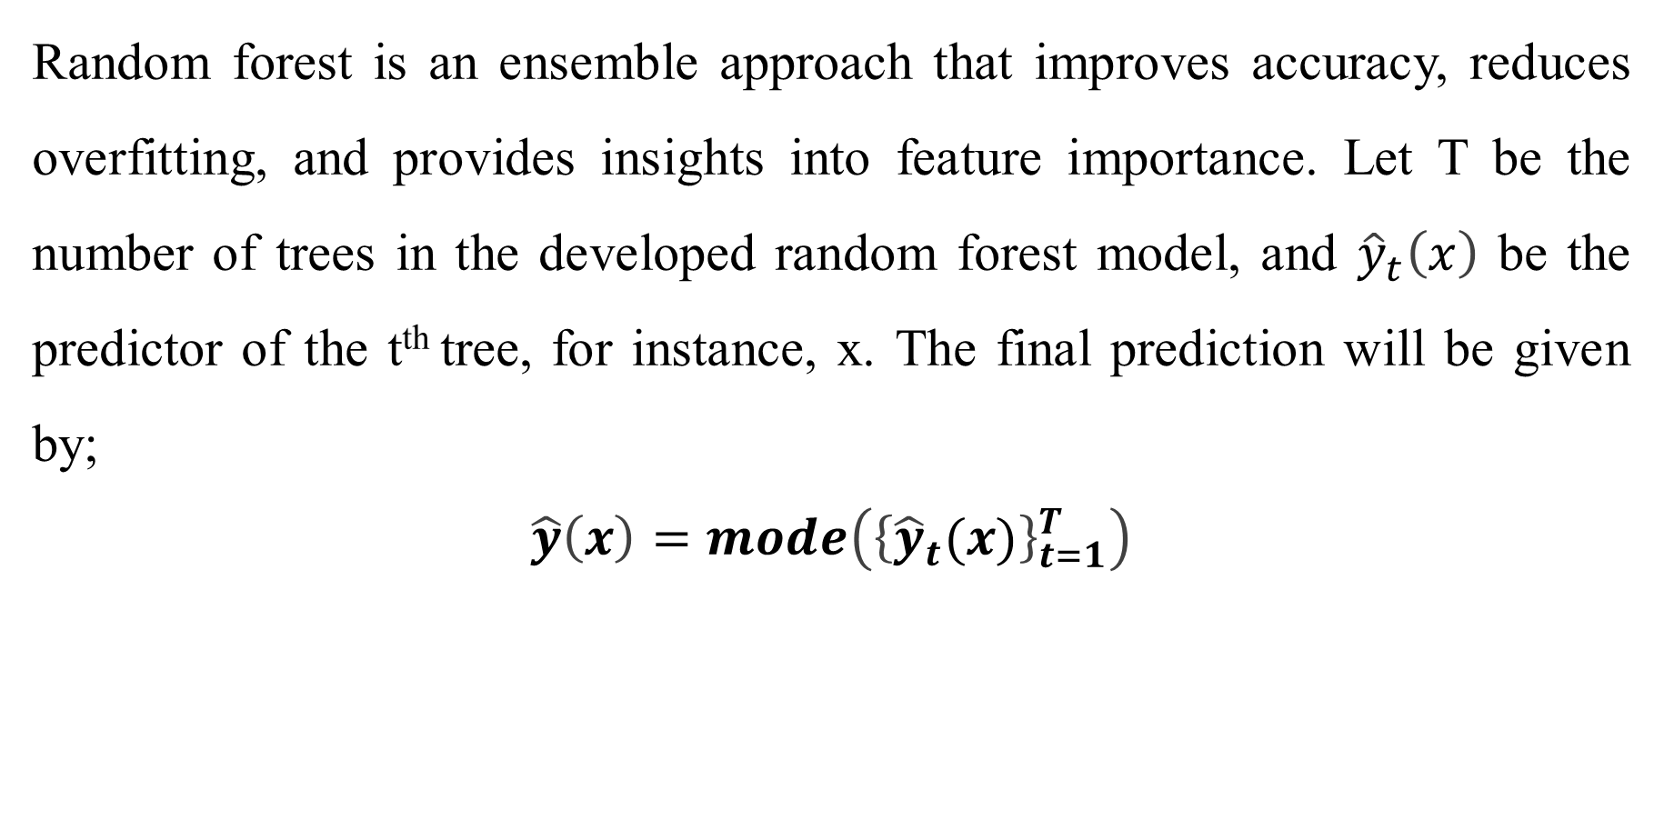
Continuation of the Random Forest
Random forest is an ensemble approach that improves accuracy, reduces overfitting, and provides insights into feature importance. Let T be the number of trees in the developed random forest model, and ${\hat{y}}_{t}\left(x\right)$ be the predictor of the t^{th} tree, for instance, x. The final prediction will be given by;
$$\hat{y}\left(x\right)=mode\left({\left\{{\hat{y}}_{t}(x)\right\}}_{t=1}^{T}\right)$$

Slide 59
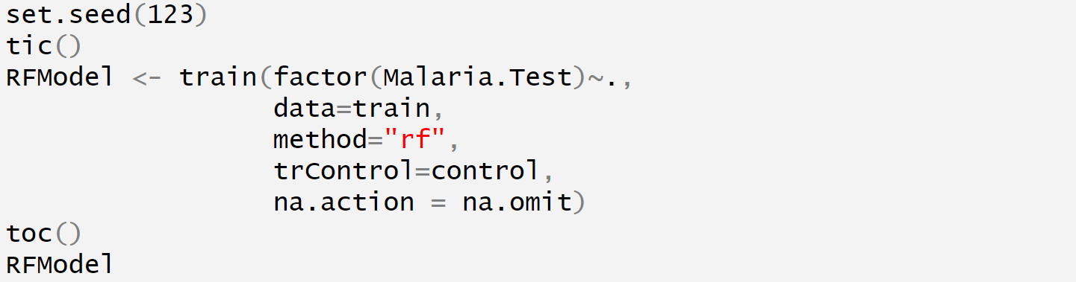
Practical Example: Random Forest Implementation in R

Slide 60
Module 3: Model Evaluation, Tuning, Handling Class Imbalance & Case Studies

Slide 61
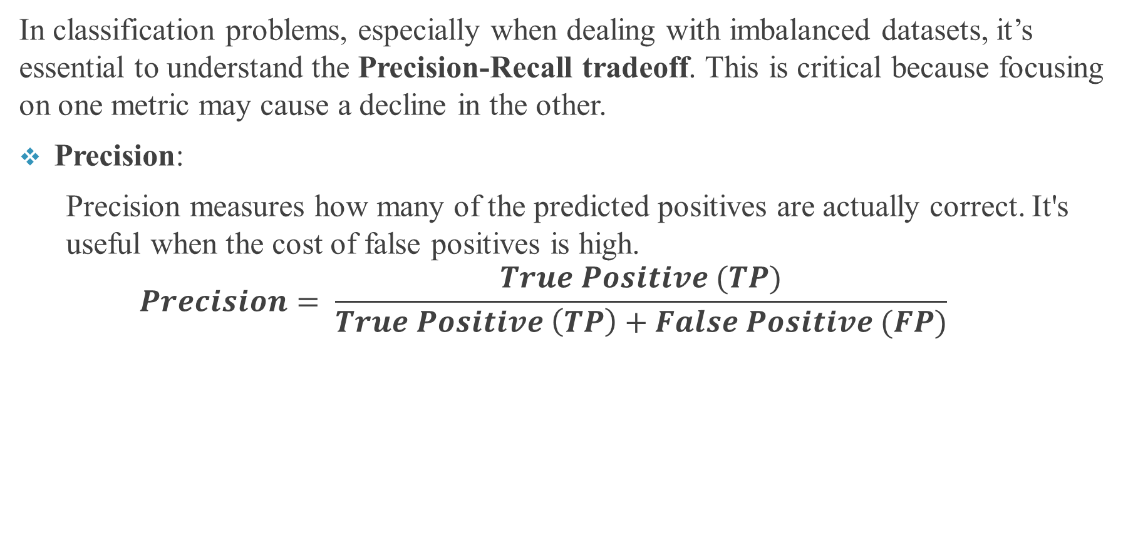
Model Evaluation: Key Concepts
In classification problems, especially when dealing with imbalanced datasets, it’s essential to understand the Precision-Recall tradeoff. This is critical because focusing on one metric may cause a decline in the other.
Precision:
  Precision measures how many of the predicted positives are actually correct. It's useful when the cost of false positives is high.
  $$Precision= \frac{True Positive (TP)}{True Positive \left(TP\right)+False Positive (FP)}$$

Slide 62
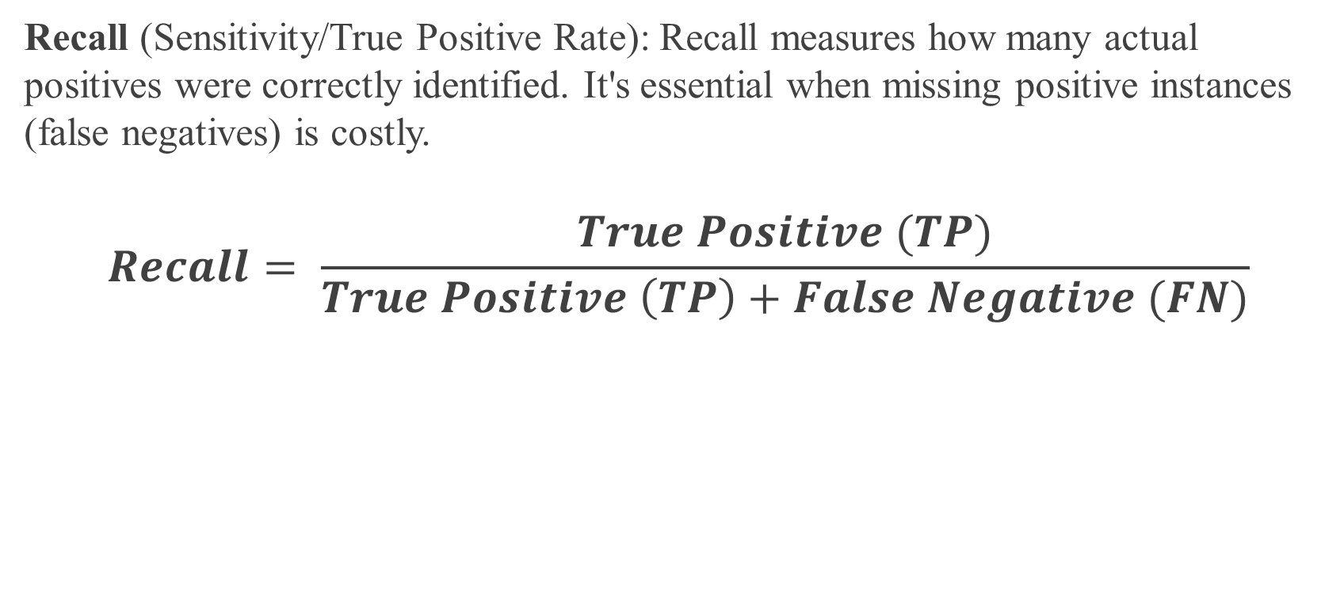
Metric Evaluation
Recall (Sensitivity/True Positive Rate): Recall measures how many actual positives were correctly identified. It's essential when missing positive instances (false negatives) is costly.
$$Recall= \frac{True Positive (TP)}{True Positive \left(TP\right)+False Negative (FN)}$$

Slide 63
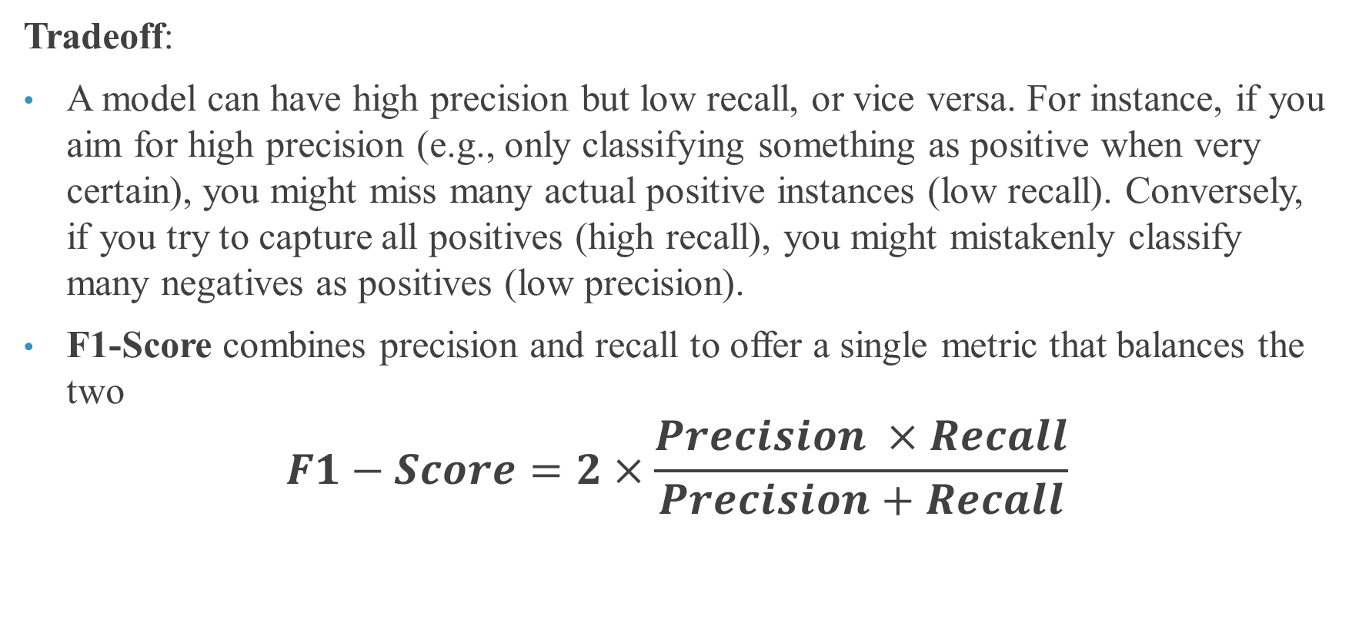
Evaluation Metrics
Tradeoff:
A model can have high precision but low recall, or vice versa. For instance, if you aim for high precision (e.g., only classifying something as positive when very certain), you might miss many actual positive instances (low recall). Conversely, if you try to capture all positives (high recall), you might mistakenly classify many negatives as positives (low precision).
F1-Score combines precision and recall to offer a single metric that balances the two
$$F1−Score=2×\frac{Precision ×Recall}{Precision+Recall}$$

Slide 64
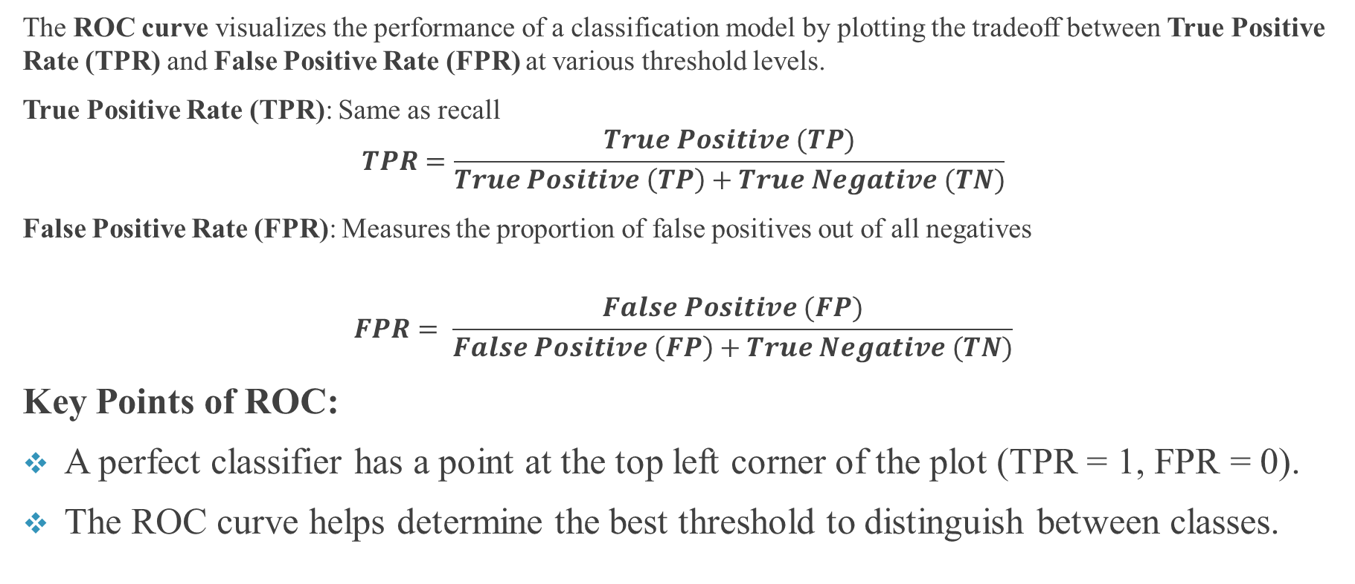
ROC (Receiver Operating Characteristic) Curve
The ROC curve visualizes the performance of a classification model by plotting the tradeoff between True Positive Rate (TPR) and False Positive Rate (FPR) at various threshold levels.
True Positive Rate (TPR): Same as recall
$$TPR=\frac{True Positive (TP)}{True Positive \left(TP\right)+True Negative (TN)}$$
False Positive Rate (FPR): Measures the proportion of false positives out of all negatives
$$FPR= \frac{False Positive (FP)}{False Positive \left(FP\right)+True Negative (TN)}$$
Key Points of ROC:
A perfect classifier has a point at the top left corner of the plot (TPR = 1, FPR = 0).
The ROC curve helps determine the best threshold to distinguish between classes.

Slide 65
AUC (Area Under the Curve)
AUC (Area Under the Curve) is the area under the ROC curve, providing a single value to summarize the model's performance.
AUC ranges between 0 and 1:
  AUC = 1: Perfect classifier.
  AUC = 0.5: Random guessing.
  AUC < 0.5: Worse than random guessing.
The closer the AUC is to 1, the better the model.

Slide 66
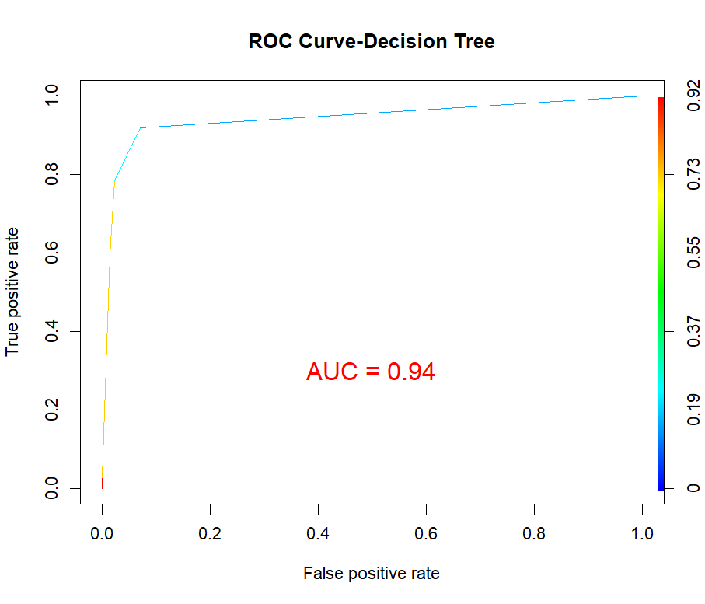
An Example of ROC and AUC

Slide 67
Adjusting Thresholds
The default decision threshold for most classifiers (e.g., logistic regression, SVM) is 0.5. However, you can adjust the threshold to tune the precision-recall tradeoff or to improve metrics like the F1-Score or ROC-AUC.
Lowering the threshold:
  Increases recall but decreases precision.
  Useful when missing positive instances is more costly.
Raising the threshold:
  Increases precision but decreases recall.
  Useful when false positives are more costly.
In practical terms, adjusting thresholds depends on the context of the problem. For example:
In medical diagnostics, you may want to maximize recall (minimize false negatives).
In spam detection, you may want to maximize precision (minimize false positives).

Slide 68
Hyperparameter Tuning
GridSearchCV and RandomizedSearchCV.
Both GridSearchCV and RandomizedSearchCV are hyperparameter tuning methods in machine learning, and they are commonly used with machine learning algorithms such as KNN, SVM, Decision Trees, Random Forests, and more.
These techniques help to improve the performance of models by finding the best set of hyperparameters.

Slide 69
GridSearchCV
GridSearchCV is an exhaustive search over a specified parameter grid. It tries all possible combinations of hyperparameters and selects the best one based on cross-validation performance.
Key Features:
Exhaustive: Tests every combination of hyperparameters from the grid.
Time-Consuming: Since it checks every combination, it can be computationally expensive, especially with a large hyperparameter space.
Best for Small Parameter Spaces: GridSearchCV works best when the number of hyperparameters and their possible values are limited.

Slide 70
Pros and Cons of GridSearchCV
Pros of GridSearchCV:
Thorough: It examines all possible combinations, ensuring you don’t miss the optimal parameters.
Cons of GridSearchCV:
Expensive: Testing all combinations can be computationally expensive and time-consuming.
Not Ideal for Large Spaces: If you have a large number of parameters or ranges, GridSearchCV can become impractical.

Slide 71
RandomizedSearchCV
RandomizedSearchCV is a more efficient alternative to GridSearchCV, as it samples a fixed number of parameter settings from the specified distribution, rather than trying every combination.
Key Features:
Random Sampling: Instead of testing every combination, it selects a random subset of the parameter space.
Faster: By testing fewer combinations, it speeds up the search process, especially for large hyperparameter spaces.
Flexibility: You can specify the number of parameter settings to sample

Slide 72
Pros and Cons of RandomizedSearchCV
Pros of RandomizedSearchCV:
Efficiency: It’s faster than GridSearchCV since it evaluates a random subset of the hyperparameter space.
Flexibility: You can control the number of iterations, making it more customizable based on available resources.
Cons of RandomizedSearchCV:
Not Exhaustive: It doesn’t test all combinations, so there’s a chance that the optimal set of parameters might not be found.
Uncertainty: Since it relies on random sampling, results may vary with different random seeds or limited iterations.

Slide 73
Tabular Comparison
Feature | GridSearchCV | RandomizedSearchCV
Search Strategy | Exhaustive search | Random sampling of parameter space
Parameter Space | Full parameter grid | Sampled from parameter distribution
Execution Time | Longer (especially for large spaces) | Faster for large parameter spaces
Control Over Combinations | Tests all combinations | Can control number of parameter settings with n_iter
Likelihood of Finding Optimal Parameters | High (as all are tested) | Lower (depending on number of iterations)
Best For | Small parameter spaces | Large parameter spaces or limited resources

Slide 74
Key take-aways
Use GridSearchCV when you have smaller hyperparameter spaces and can afford the computation time.
Use RandomizedSearchCV when the hyperparameter space is large, and you need faster results or have limited computational resources.
Both techniques use cross-validation to evaluate model performance, ensuring that the selected hyperparameters generalize well to unseen data.

Slide 75
Handling Class Imbalance
Imbalanced data in machine learning refers to datasets where the classes (categories) are not represented equally, i.e., one class significantly outnumbers the others. This is common in classification problems where the number of instances of one class (the majority class) greatly exceeds the number of instances of the other class (the minority class).
Examples of Imbalanced Data:
Fraud detection: Most transactions are legitimate, while fraudulent ones are rare.
Medical diagnosis: Most patients are healthy, while only a small portion has a particular disease.
Spam detection: Most emails are not spam, while a small fraction are spam.

Slide 76
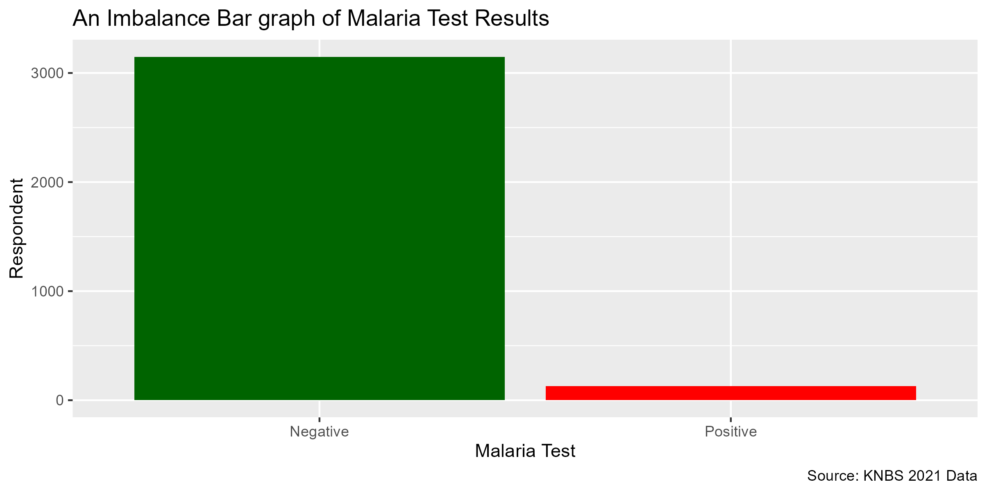
Graphical Representation of Imbalance Data

Slide 77
Why Imbalanced Data is Challenging:
Skewed Performance Metrics:
If you have 95% of the data belonging to Class A and 5% to Class B, a naive model predicting every instance as Class A will still have an accuracy of 95%. However, this model completely fails to identify Class B cases, making accuracy a misleading metric.
Bias Toward Majority Class:
Most algorithms tend to be biased towards the majority class, meaning that they may overlook or underpredict the minority class.
Poor Generalization:
Models trained on imbalanced datasets may generalize poorly when applied to unseen data, particularly in recognizing rare events (the minority class).

Slide 78
Handling and Addressing Imbalance Data
Resampling Methods:
Oversampling the minority class:
Increasing the number of instances of the minority class (e.g., using techniques like SMOTE—Synthetic Minority Oversampling Technique).
Undersampling the majority class:
Reducing the number of instances from the majority class.

Slide 79
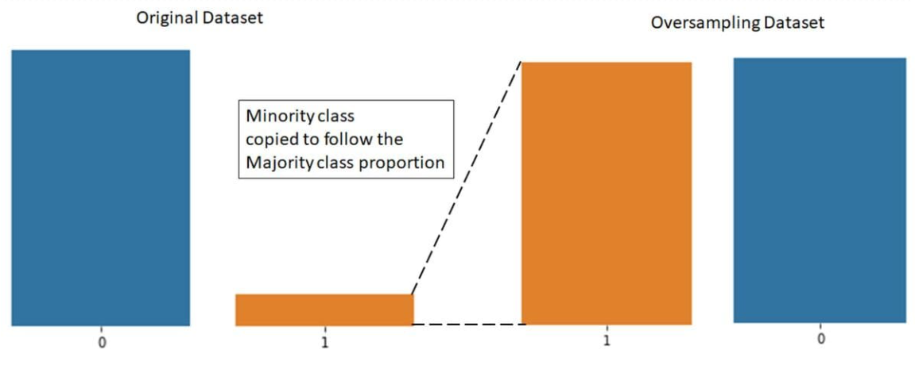
Oversampling of the Minority Class
SMOTE—Synthetic Minority Oversampling Technique

Slide 80
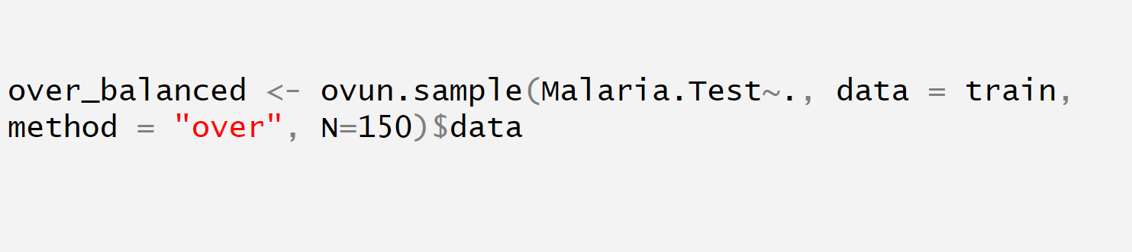
R code for Oversampling

Slide 81
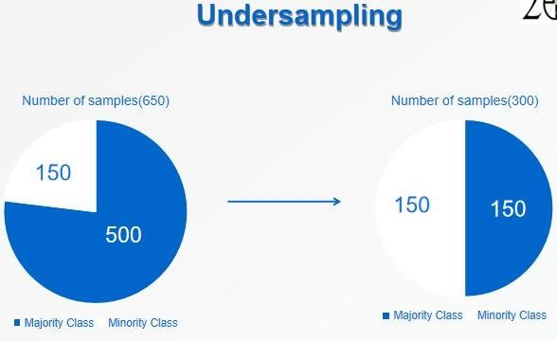
Under-sampling of the Majority Class

Slide 82
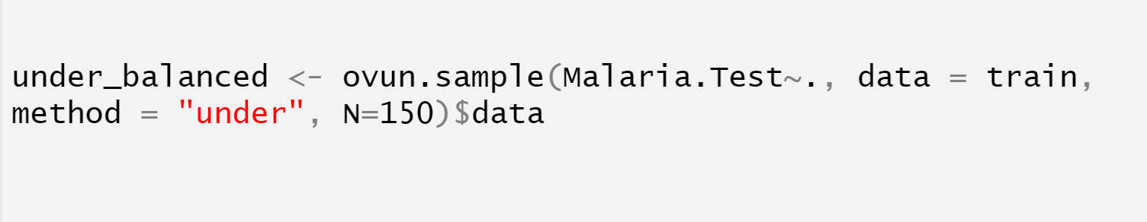
R-code to Under-sampling the Majority Class

Slide 83
Hybrid Sampling (Combined Resampling)
Combined resampling refers to the technique of integrating both oversampling and undersampling methods to handle imbalanced datasets. This approach aims to create a balanced class distribution while retaining the informative instances from both the majority and minority classes.
Key Aspects of Combined Resampling:
Purpose:
  The main goal is to mitigate the shortcomings of using either oversampling or undersampling alone. By combining both methods, you can enhance the model's performance, reduce overfitting, and improve the generalization ability of the model.
How It Works:
  Typically, you first apply one method (either oversampling or undersampling) and then use the other method to refine the resulting dataset. For example, you might first perform oversampling on the minority class to increase its representation, then apply undersampling to reduce the number of instances from the majority class.
Benefits:
  Retention of Information: Combined resampling retains valuable information from the majority class while also ensuring that the minority class is sufficiently represented.
  Reduced Overfitting Risk: By not solely relying on oversampling (which can lead to overfitting), the model can better generalize to unseen data.
  Better Class Separation: Helps in creating clearer decision boundaries between the classes.

Slide 84
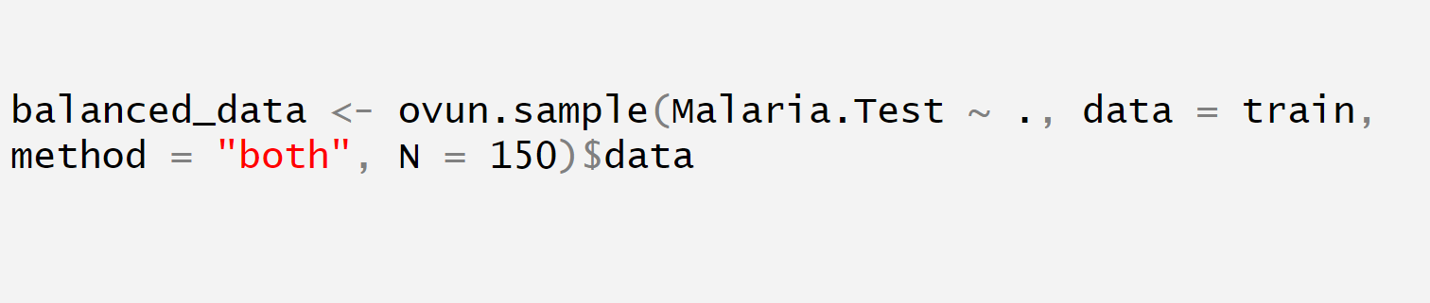
R-code for Implementing Combined Resampling

Slide 85
Performance Metrics for Imbalanced Data:
Instead of accuracy, metrics such as;
Balanced Accuracy
Precision
Recall
F1-Score
ROC-AUC
Precision-Recall AUC
are better suited to evaluate model performance on imbalanced data.

Slide 86
Bias-Variance Tradeoff
Bias-Variance Trade-Off
The bias-variance trade-off is a fundamental concept in machine learning that describes the balance between a model's ability to generalize to new data versus its performance on the training data.
Bias refers to the error introduced by approximating a complex problem with a simple model. A model with high bias pays little attention to the training data, leading to systematic errors (i.e., underfitting).
Variance refers to the model's sensitivity to the specific training data it has been given. A model with high variance fits the training data very closely (even capturing noise), but may fail to generalize to new data (i.e., overfitting).
The goal of a machine learning model is to minimize both bias and variance to achieve good performance on both the training and test sets.

Slide 87
Underfitting (High Bias)
Underfitting occurs when the model is too simple to capture the underlying patterns in the data. This leads to poor performance on both the training data and unseen test data.
Characteristics of Underfitting:
High Bias: The model does not capture enough of the complexity of the data, leading to systematic errors.
Poor Training and Test Performance: Both training error and test error are high.
Common in Models: This happens with overly simple models, such as:
  Linear models for highly non-linear data.
  Decision trees with very few splits.
Example:
Imagine trying to fit a straight line to non-linear data. The model will not capture the nuances of the data, resulting in a high error for both training and test sets.

Slide 88
Overfitting (High Variance)
Overfitting occurs when the model is too complex and fits the training data too closely, even capturing noise or random fluctuations in the data. This leads to good performance on the training set but poor generalization to new data.
Characteristics of Overfitting:
High Variance: The model is too sensitive to the specific data points in the training set, including noise.
Good Training Performance, Poor Test Performance: Training error is very low, but test error is high.
Common in Models: This happens with models that are too complex, such as:
  Decision trees with deep branches (many splits).
  Neural networks with too many layers or parameters.
  Overly complex polynomial regressions.
Example:
Imagine trying to fit a high-degree polynomial to a dataset with a few points. The model may pass through all the points in the training set but will fail to predict future points accurately.

Slide 89
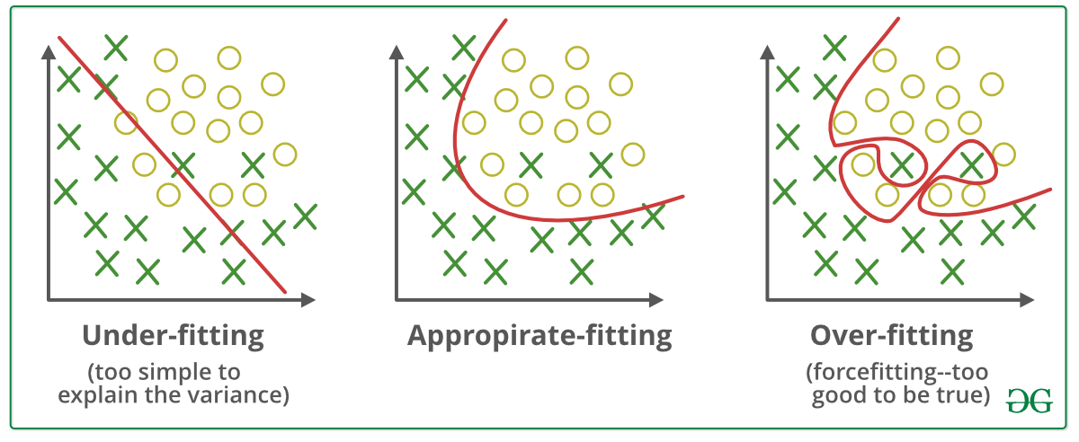
Diagrammatic Representation of Overfitting and Underfitting

Slide 90
Techniques to Balance Bias and Variance
To achieve a good balance between bias and variance (i.e., neither underfitting nor overfitting), the following techniques are used:
Cross-Validation:
  Use techniques like k-fold cross-validation to estimate model performance on unseen data.
  It helps in finding a model that generalizes well without overfitting.
Regularization:
  Techniques such as L1 (Lasso) and L2 (Ridge) regularization add penalties for large coefficients in the model, preventing overfitting.
  Example: In linear regression or logistic regression, regularization reduces the impact of features with small contributions to the outcome.

Slide 91
Techniques to Balance Bias and Variance
3. Model Complexity Control:
For models like decision trees and random forests, controlling model complexity helps.
  Limit the depth of trees.
  Use pruning to remove unnecessary branches.
4. Ensemble Methods:
Techniques like bagging, boosting, and random forests combine multiple models to reduce variance.
Example: Random Forests train multiple decision trees and average their results, reducing overfitting.
5. Dimensionality Reduction:
Use techniques like Principal Component Analysis (PCA) to reduce the number of features and remove noise.
Reducing the dimensionality can simplify the model and avoid overfitting, especially when the number of features is large compared to the number of observations.

Slide 92
Techniques to Balance Bias and Variance
6. Simpler Models:
  Sometimes, using simpler models like logistic regression or linear regression can prevent overfitting, especially for small datasets.
7. Data Augmentation:
  If overfitting occurs due to limited training data, augmenting the dataset can improve the model's generalization.
  This is particularly useful in domains like image classification.
8. Tune Hyperparameters:
  Use methods like GridSearchCV or RandomizedSearchCV to fine-tune hyperparameters and find the right balance between model complexity and regularization.

Slide 93
Tabular Showing Underfitting and Overfitting
Model Complexity | Training Error | Test Error | Bias | Variance
Low (Underfitting) | High | High | High | Low
Medium (Ideal) | Low | Low | Balanced | Balanced
High (Overfitting) | Very Low | High | Low | High

Slide 94
Feature Importance and Selection
Why Feature Selection is Important
Feature selection is a crucial step in the machine learning pipeline, aimed at identifying the most relevant input variables (features) that contribute to the target variable's prediction. It helps in:
Reducing Overfitting: Too many irrelevant features can cause a model to learn noise, leading to overfitting and poor generalization on new data.
Improving Model Performance: Removing redundant or irrelevant features often enhances the accuracy and efficiency of a model. It leads to faster training times and reduced complexity.
Enhancing Interpretability: Models with fewer features are easier to interpret and understand, which is crucial for communicating results to stakeholders.
Reducing Computational Cost: With fewer features, models require less computational power and storage, making the process faster and more efficient, especially with large datasets.

Slide 95
Recursive Feature Elimination (RFE)
Recursive Feature Elimination (RFE) is a feature selection method that fits a model and recursively removes the least important features. At each iteration, the model ranks features based on their importance, and the least significant ones are eliminated until the desired number of features is reached.
How RFE Works:
  A model is trained on the entire set of features.
  The model ranks the features by importance (e.g., using coefficients for linear models or feature importance for tree-based models).
  The least important features are removed.
  Steps 1–3 are repeated until a predefined number of features is selected.
Advantages:
  Efficient for finding the most predictive subset of features.
  Works well with most types of models, especially when using feature importance from tree-based models or coefficients from linear models.

Slide 96
Lasso (L1) Regularization for Feature Selection
Lasso Regression (L1 Regularization) is a technique that can perform both regularization and feature selection. Lasso adds a penalty equal to the absolute value of the magnitude of coefficients, shrinking some coefficients to exactly zero. This results in sparse models where irrelevant features have no influence on predictions.
How Lasso Works:
  Lasso minimizes the residual sum of squares plus a penalty proportional to the sum of the absolute value of the coefficients.
  As the regularization parameter increases, more coefficients shrink to zero, effectively performing feature selection.
Advantages:
  Lasso is simple and effective for high-dimensional data (when the number of features is larger than the number of observations).
  Automatically selects features as part of the learning process by setting irrelevant feature coefficients to zero.

Slide 97
Summary of the two Techniques
Technique | Description | Model Compatibility
Recursive Feature Elimination (RFE) | Iteratively removes the least important features based on model coefficients or feature importance. | Any model, especially tree-based and linear models.
Lasso Regression | Shrinks coefficients to zero using L1 regularization, performing feature selection in the process. | Linear models, Lasso is particularly effective when the number of features is large.

Slide 98
Key Takeaways
Feature selection is critical to improve model performance, reduce overfitting, and simplify model interpretation.
Recursive Feature Elimination (RFE) is an efficient and model-agnostic method that eliminates the least important features in a recursive process.
Lasso Regression (L1 Regularization) performs feature selection automatically by penalizing the size of the coefficients, setting irrelevant ones to zero.

Slide 99
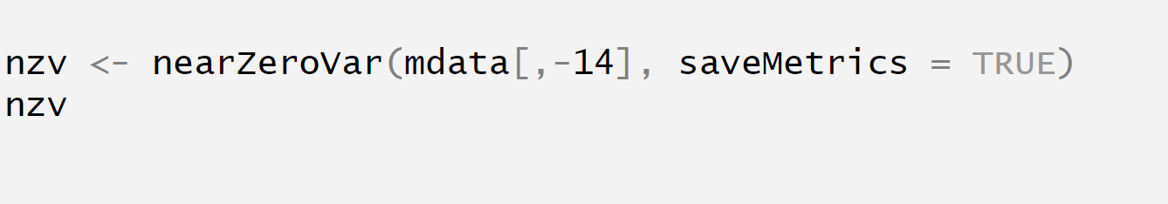
Features Selection in R

Slide 100
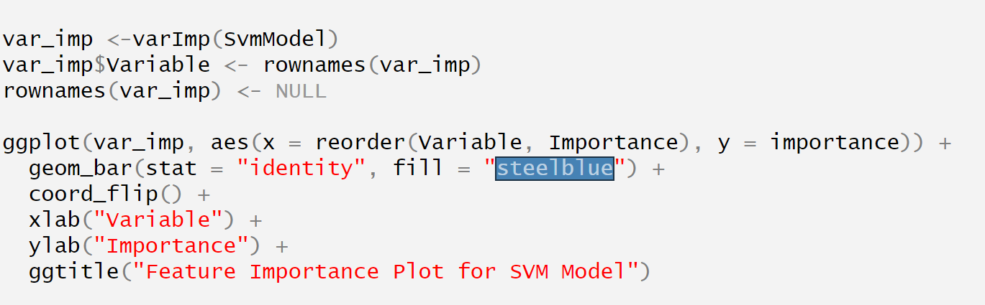
Practical Example: Feature Importance R

Slide 101
Case Study 1: Predicting Loan Default (Classification)
Walk through a real-world case study using SVM or Random Forest.
Steps: Data preprocessing, model building, evaluation, and tuning.

Slide 102
Case Study 2: Predicting House Prices (Regression)
Walk through using Decision Tree or Random Forest.
Data preparation, training the model, evaluation metrics, hyperparameter tuning.

Slide 103
Model Deployment using Shinydahsboard
Model deployment using ShinyDashboard allows for the creation of interactive, web-based applications where users can interact with machine learning models in real-time.
By leveraging R’s Shiny framework, developers can seamlessly integrate model predictions, visualizations, and user inputs into a user-friendly dashboard interface.
The dashboard enables stakeholders to explore model results, adjust input parameters, and view dynamic outputs without needing deep technical expertise.
Additionally, ShinyDashboard facilitates easy sharing and access to deployed models over the web, making it ideal for collaborative decision-making and reporting.

Slide 104
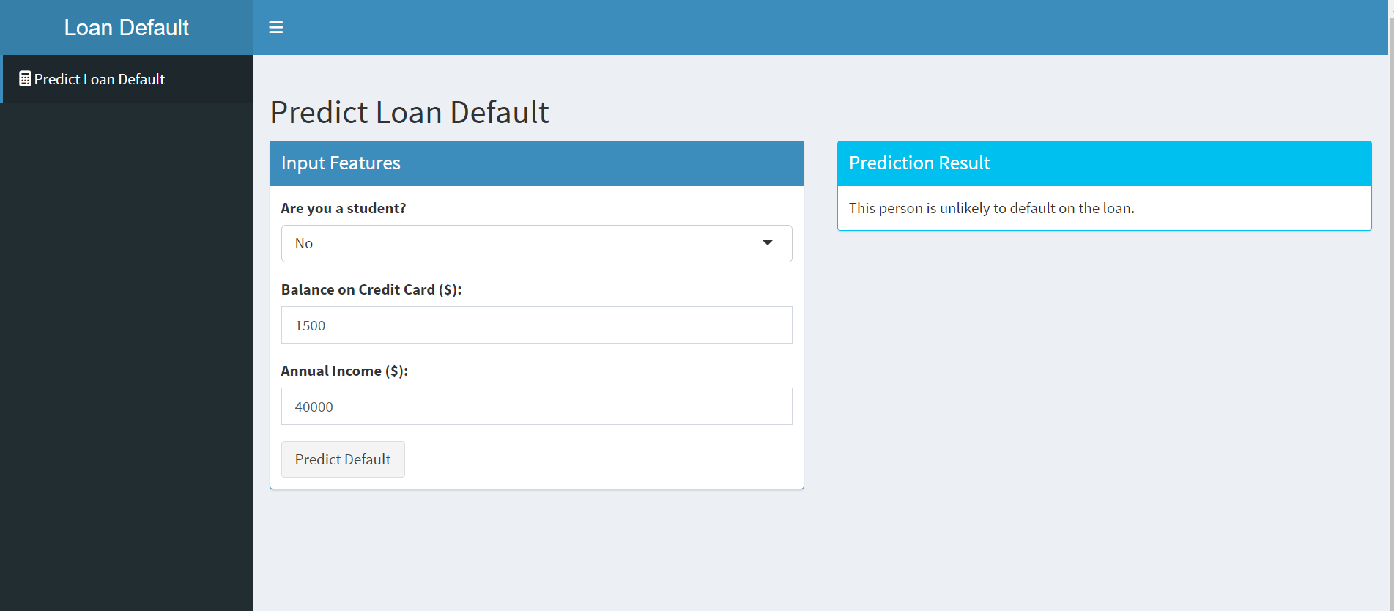
An Example of a Shiny App Dashboard
Link to the dashboard is given below
https://29619296-1992-lumumba-victor.shinyapps.io/LOAD_DEFAULT/

Slide 105
Q&A and Hands-On Projects
Suggestions for hands-on projects. (e.g. a research project, journal)
Sample datasets to work with (e.g., Titanic dataset, Boston Housing, diabetes, load default, malaria data).

Slide 106
More Resources
Visit my GitHub account for more resources, materials and datasets.
For malaria modeling using machine, visit the GitHub page section below
https://github.com/Lumumba1992/ML-FOLDER-ONE
For general knowledge in machine learning and predictive modeling, visit the GitHub page section below
https://github.com/Lumumba1992/Machine-Learning-with-Rstudio

